Slide 1
Sequence Modeling: Recurrent and Recursive Nets (10.1-10.5)
Jaehyoung Hong

Slide 2

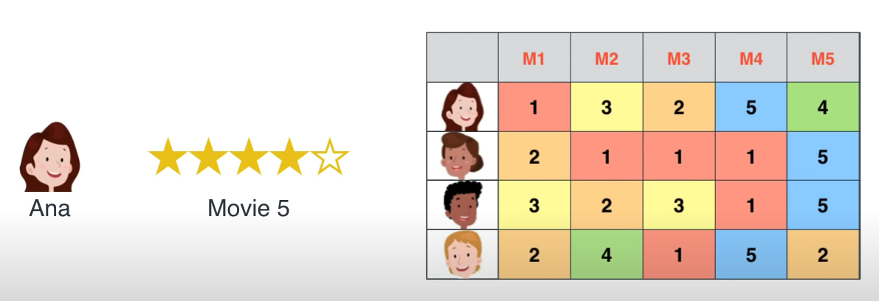

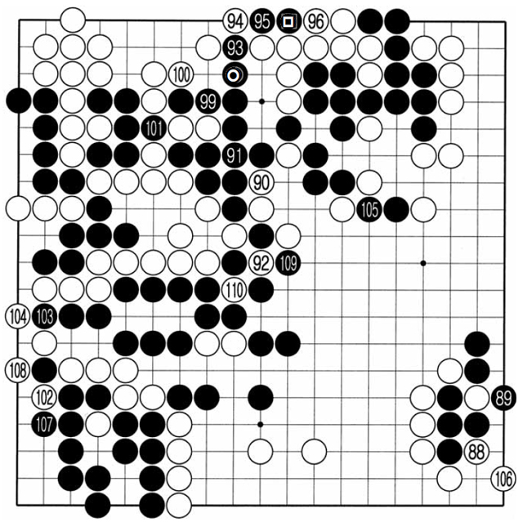

Recurrent neural network(RNN) is specialized for sequence-like input
CNN → Specialized for grid-like input
Image
Netflix problem (Rating of movie)
Fixed input (Given for one time-step)
RNN → Specialized for sequence-like input
For many case, each time-point of sequence are correlated with each other
Language
Go
$x^{(t)}$ and $x^{(t+1)}$ are correlated

Slide 3
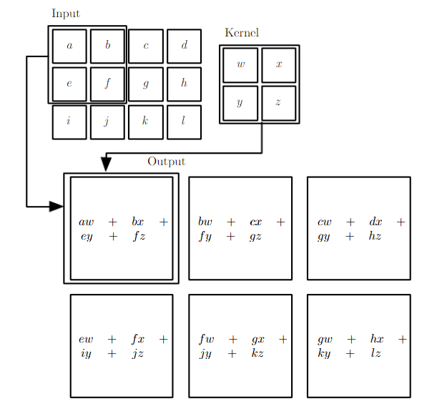
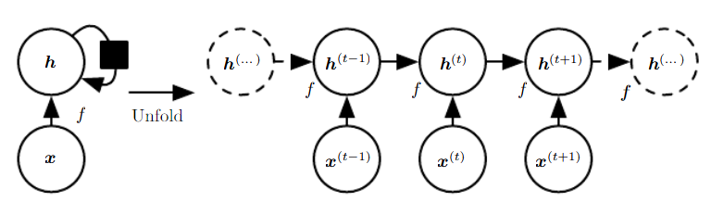
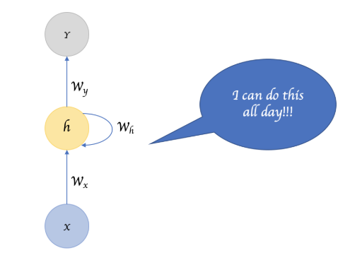

Like CNN, RNN can handle various length of sequence by using parameter sharing
hidden
hidden
input
input
Same function / parameter
RNN : Using same weight (parameter) for each time-step (parameter sharing)
CNN : Using same kernel (parameter sharing)
Handle various length of image
Handle various size of image

Slide 4
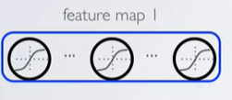
By parameter sharing, RNN is invariant under position
I went to Nepal in 2009
In 2009, I went to Nepal
Eye must be detected as eye although it has different position
RNN : Using same weight (parameter) for each time-step (parameter sharing)
CNN : Using same kernel (parameter sharing)
Same input gives same feature
Same word gives same meaning

Slide 5
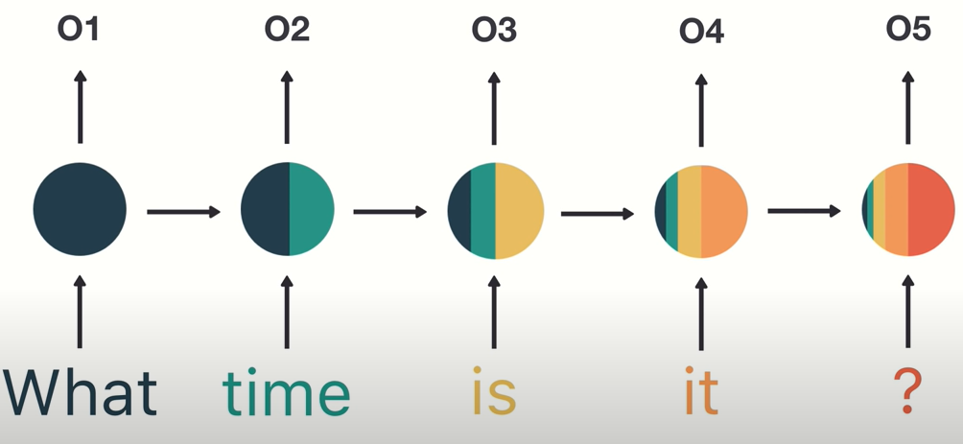
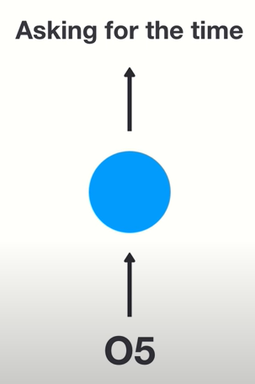
Description of RNN

Slide 6
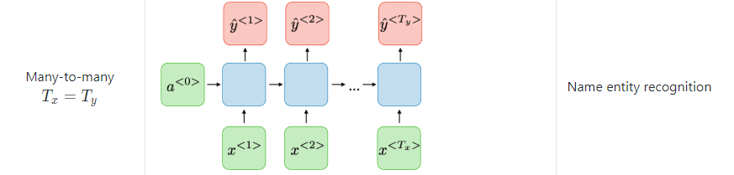







First, we consider sequence-to-sequence RNN
$$x^{(1)}$$
$$x^{(2)}$$
$$x^{(3)}$$
Input
I
hear
Berlin
$$y^{(1)}$$
$$y^{(2)}$$
$$y^{(3)}$$
<Name entity recognition>
Output
[ ]
[ ]
Place

Slide 7

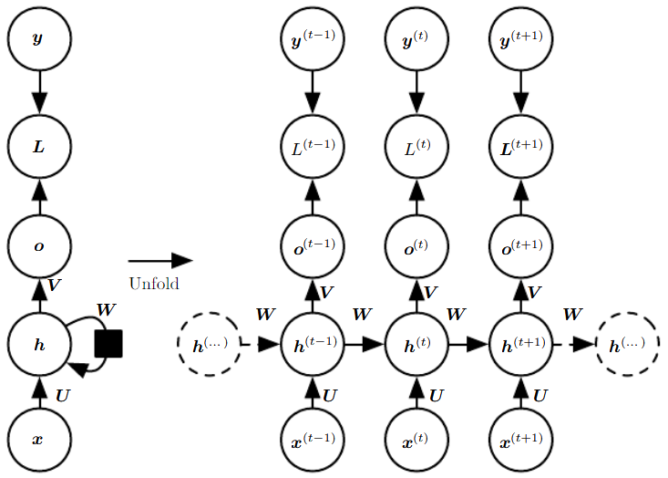
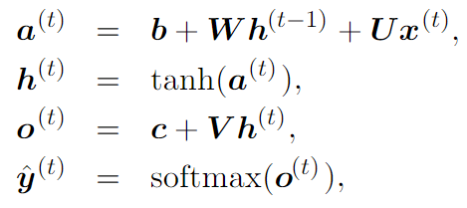
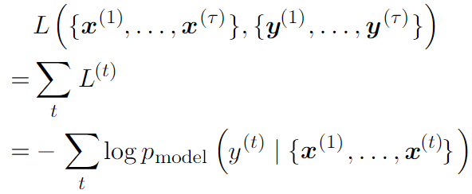
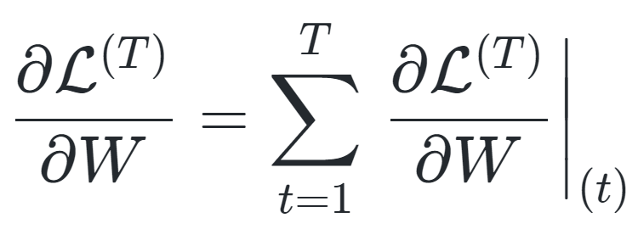



Such RNN can be defined as recurrent form from $t=1$to $t=τ$
RNN
Same parameter!!
Output
Total loss is sum of losses over all the time steps
Total loss is sum of losses over all the time steps
Loss
Input
Runtime : $O(τ)$
Gradient
Previous information influenced on current information only through hidden state (h)
Memory : $O(τ)$
(Backpropagation through time : BPTT)

Slide 8
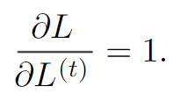
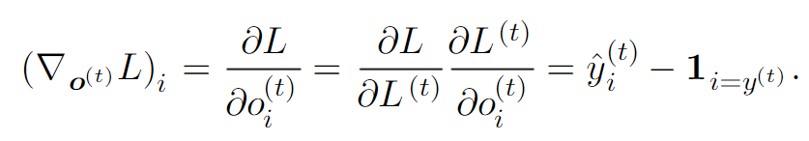

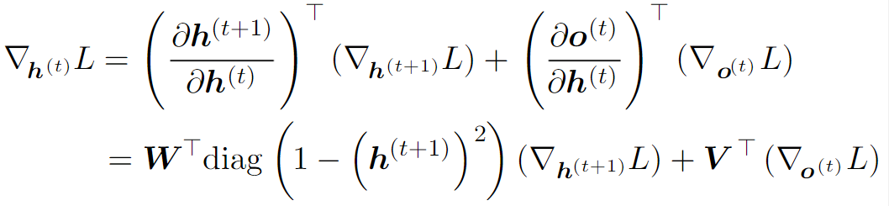
Example of calculation of BPTT
Follow the arrow
(1)
(2)
Output
(3)
Input

Slide 9
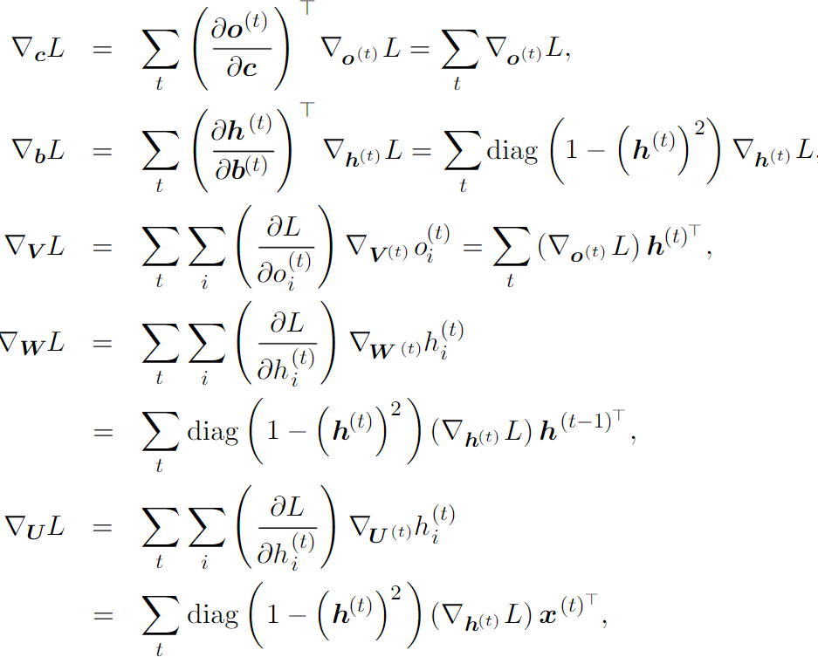
Example of calculation of BPTT
Follow the arrow
Output
Input
Bad Result
$W=W^{(1)}=…=W^{(τ)}$, $U=U^{(1)}=…=U^{(τ)}$, $V=V^{(1)}=…=V^{(τ)}$

Slide 10
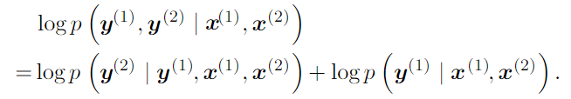
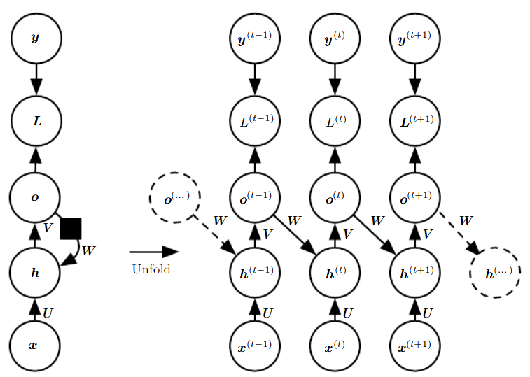
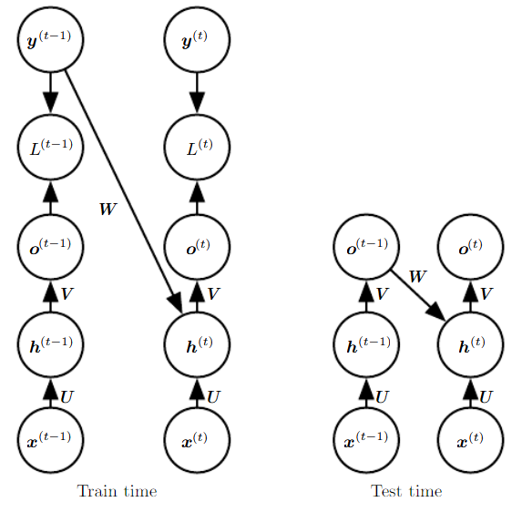
We can use previous information from output to better trained the RNN (Teacher forcing)
Generally less powerful :
Output has less information than hidden
Teacher forcing : Use output as next input
Avoid BPTT !! (No hidden-to-hidden)

Slide 11
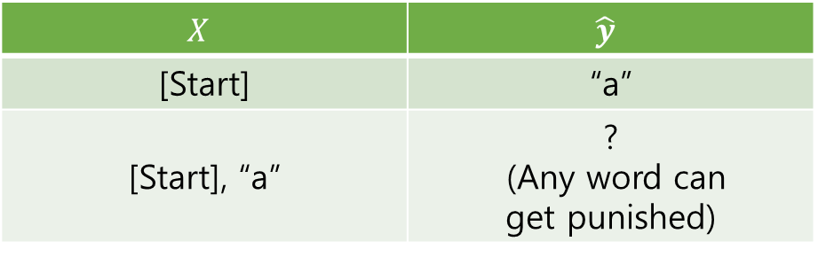
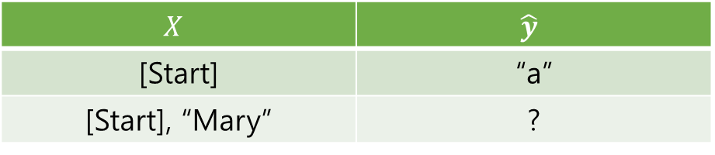
We can use previous information from output to better trained the RNN (Teacher forcing)
Want to train?
“Mary had a little lamb whose fleece was white as snow”
$$X$$ | $$\hat{y}$$
[Start] | “a”
[Start], “a” | ? (Any word can get punished)
<Without teacher forcing : Slow & incorrect>
$$X$$ | $$\hat{y}$$
[Start] | “a”
[Start], “Mary” | ?
Teacher forcing : Use output as next input
With teacher forcing

Slide 12
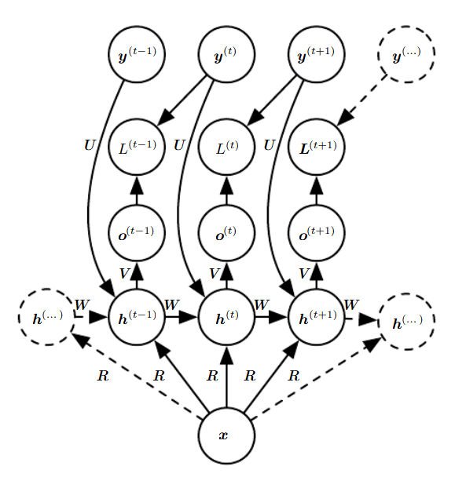
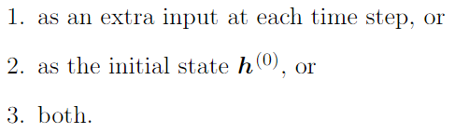

RNN which takes single vector as input
When input is $x$ rather than $x^{(t)}$
$x^{T}R$ is added as additional input to the hidden units
$x^{T}R$ is new bias parameter
$P\left(y|x\right)→P\left(y | w\right), w=f(x)$

Slide 13
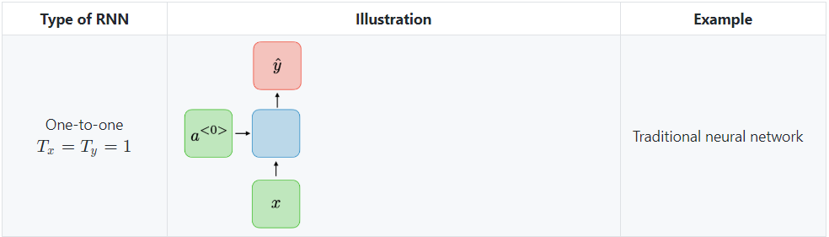
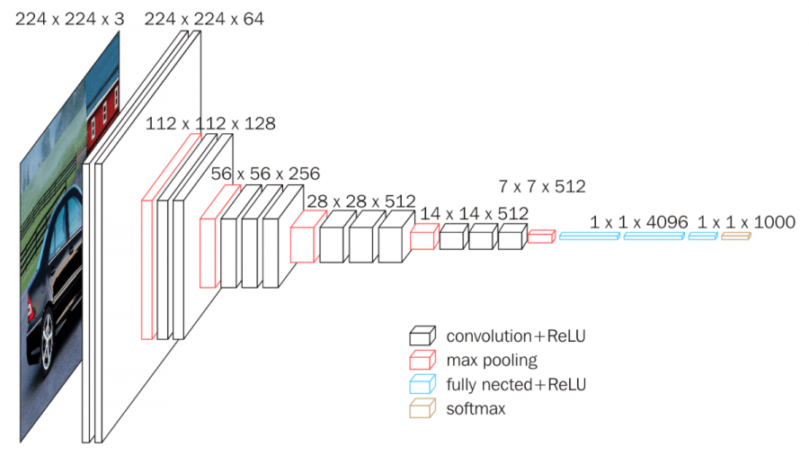
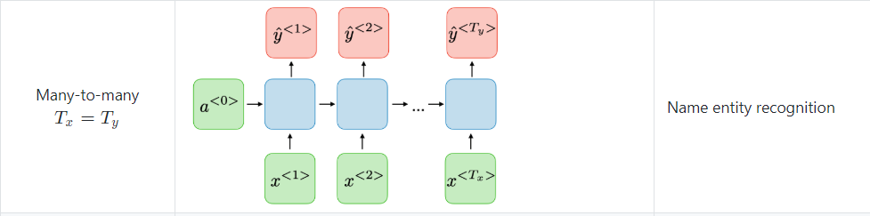
Variant type of RNN : Depending on Input and Output

Slide 14
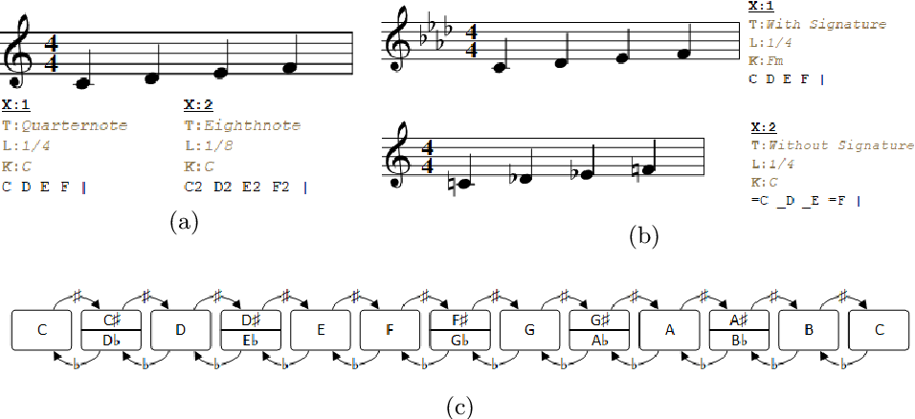
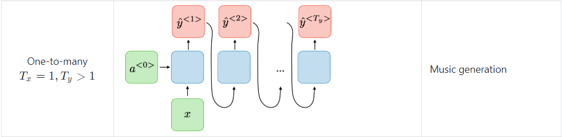
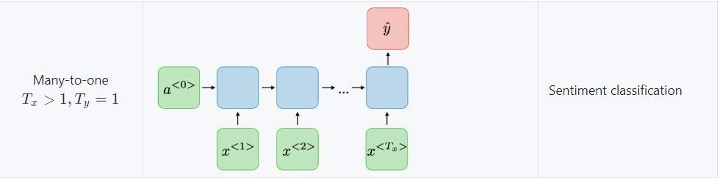
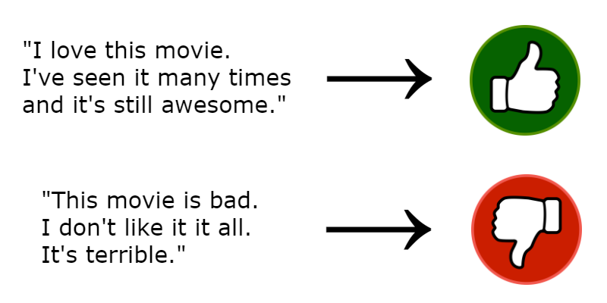
Variant type of RNN : Depending on Input and Output

Slide 15
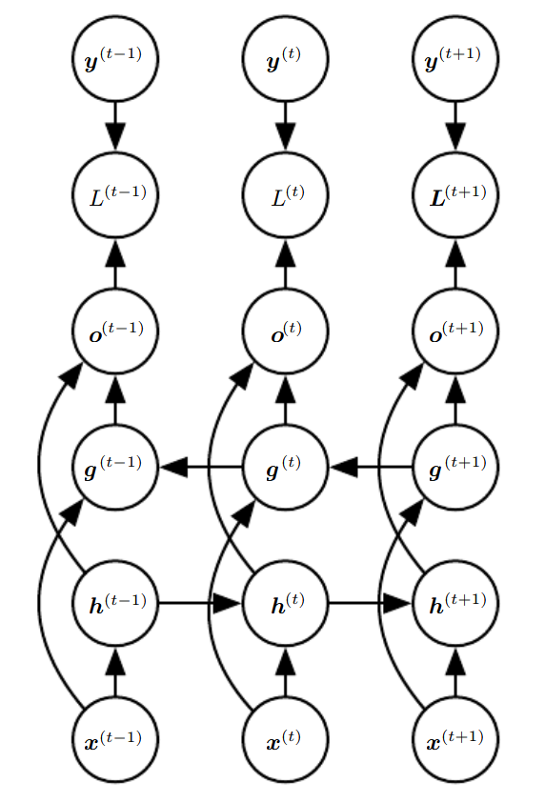
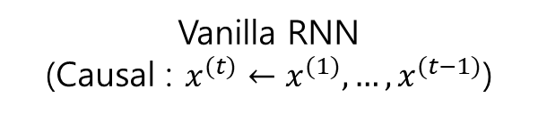
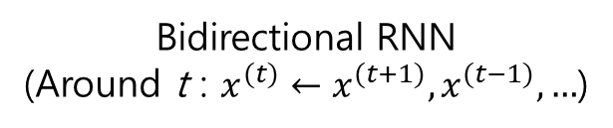
Various type of RNN : Bidirectional RNNs using future information
Example
Speech recognition
Handwriting recognition
Bioinformatics
Vanilla RNN
(Causal : $x^{(t)}←x^{(1)},…{,x}^{(t−1)}$)
Sub-RNN (Backward)
vs
Sub-RNN (Forward)
Bidirectional RNN
(Around t : $x^{(t)}←x^{(t+1)},x^{(t−1)},…$)

Slide 16
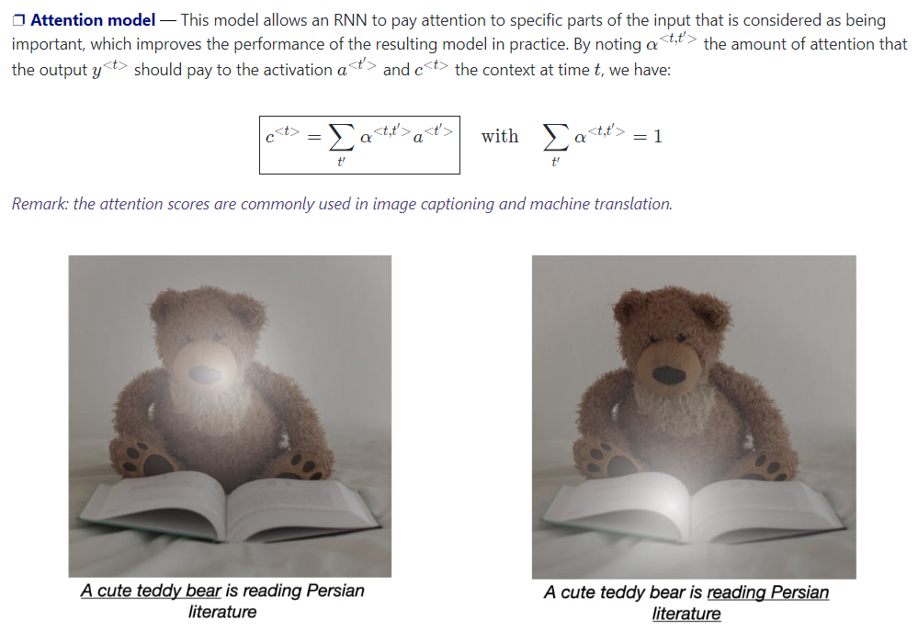
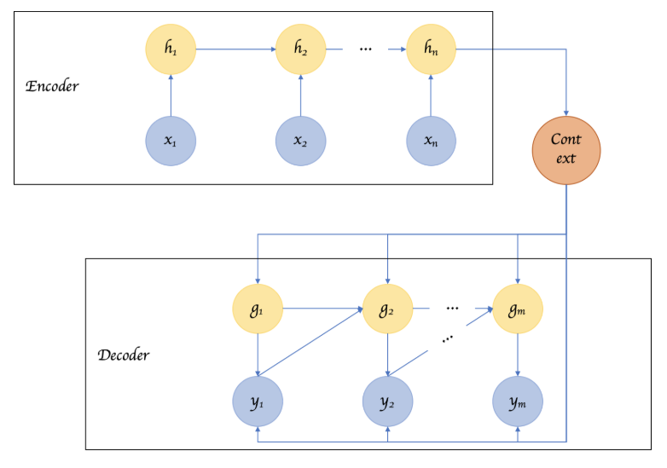
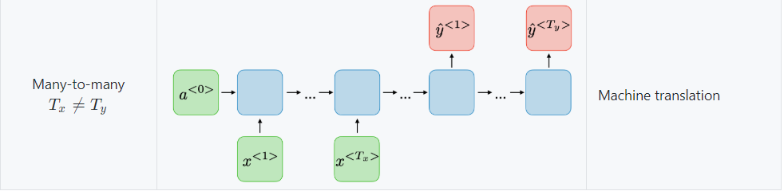




Encoder-Decoder Sequence-to-Sequence RNN provide output having different length with input
Usually we call input to the RNN as ‘Context’
$$X=(x^{\left(1\right)},…,x^{{(n}_{x})})$$
Encoder : Sequence to context
The last state $h_{n_{x}}$ of the encoder used as a Context
Decoder : Context to sequence
$$Y=(y^{\left(1\right)},…,y^{{(n}_{y})})$$
$$n_{x} ≠n_{y}$$
Maximize $logP(y^{\left(1\right)},…y^{{(n}_{y})}|x^{\left(1\right)},…,x^{{(n}_{x})})$

Slide 17
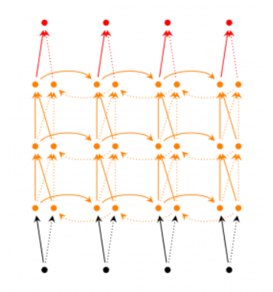
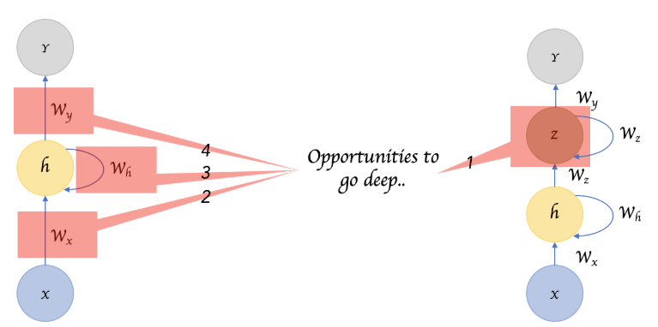
RNN has opportunities to make deep RNN
Deep RNN

